Slide 1
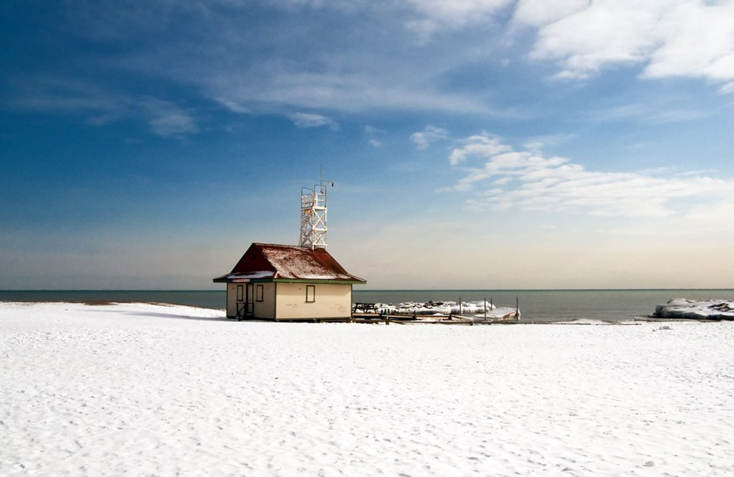
Please submit your answers to info@willysac.ca by January 9th 2022 to be in the running!
Willy’s Wonderful Winter Wonderland Walk
Take a wander and solve some clues to win a gift card or two to spend at local businesses!
Participation is by donation via the school cashless program with recommended donation of $10 per entry.

Slide 2
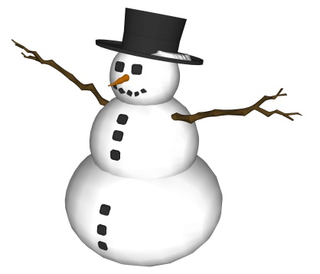
Magical Mathematical Meander
Take a walk along Queen Street and take note of all our local businesses and organizations as you wander by.
The clues are in the names! Write down the street number of where the business is located.
Add together all the street numbers, and what number do you get? _ _ _ _ _
Find these three birds.
  OWL
  PARROT
  GULL
I have a fluffy mane and made of stone
In the olden days, you can write on me with chalk
_ _ _ _ _ (5 letters)
I make buzzing noises
The _ _ _ _ _ _ _ _ (5, 3 letters)
I am a tasty vegetable when BBQed!
The Green _ _ _ _ _ _ _ _ (8 letters)
My fire hydrant is painted like a dalmatian
I like to chase mice, and when I am happy I will purr
4_ _ _ _ _ _ _ _(3, 5 letters)
What does the _ _ _ say?
The _ _ _ _ _ _ _ _ _ _ _
Add together all the street numbers and what do you get?

Slide 3

Stroll and Spot
Take a stroll and see the sights!
There are two parrots in the neighbourhood (both are in their business signs). What streets are they on?
I could be a squirrel or chipmunk (let me know what you think!), but I have a very, very sweet tooth? (business)
I am a herb that you may eat with tomatoes (restaurant name)
Across from Williamson Rd School is a house with a light on the garage and a bird house. What two colours are these?
You may walk past me on Lee Ave and see me everyday day.
  I am a paddle board – what is my name?
  I am holding two coloured ice-creams, and look very happy. What colour ice-creams am I holding?
  Bonus question – there is at least 4 stores that sell ice-cream cones in the neighbourhood, can you name them?
In Kew Beach Park there are at least 5 sports you can play. Some are Summer and some are Winter sports. Name these.
Where is the reindeer crossing?
Who erected the wading pool at Castle Park?

Slide 4
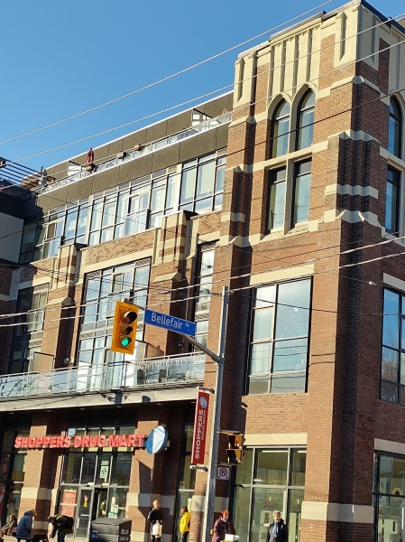
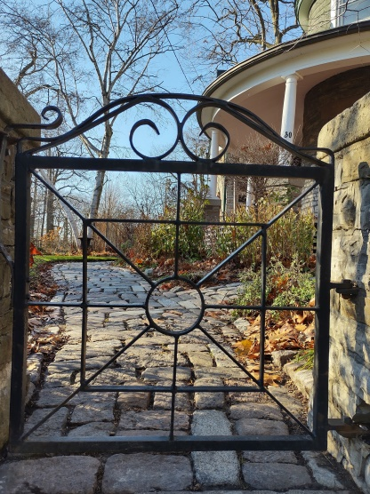
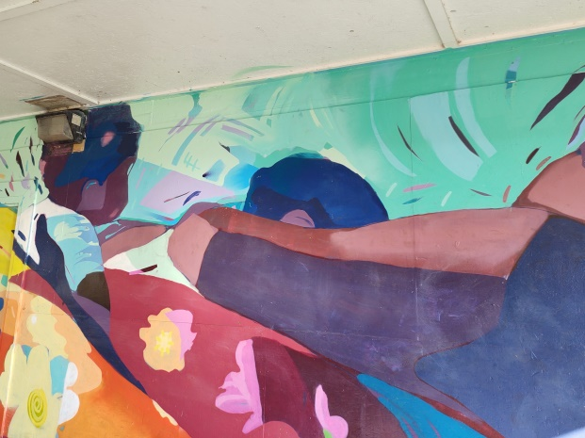
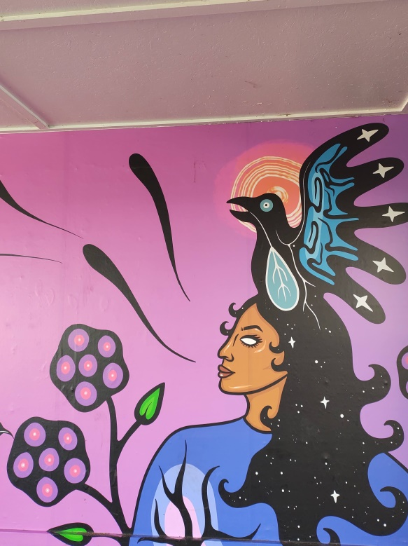
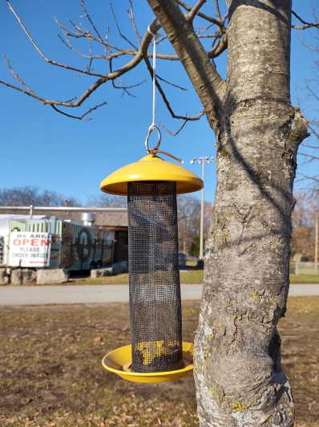
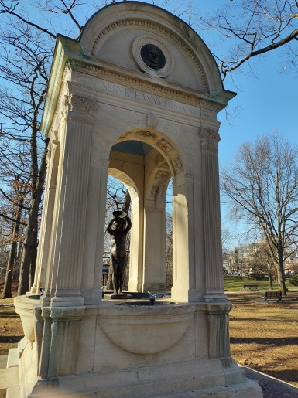
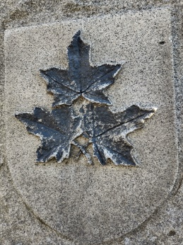
Picture perfect plodding
2. What was I before I became Shoppers?
3. Who was my last family member to live here?
1. Read about these beautiful murals and tell me who the artists are.
4. Who erected me?
5. What did Dick and Pat wish to do?
6. I was erected for a doctor who helped during the Spanish Flu Pandemic. What is the doctors name?

Slide 5
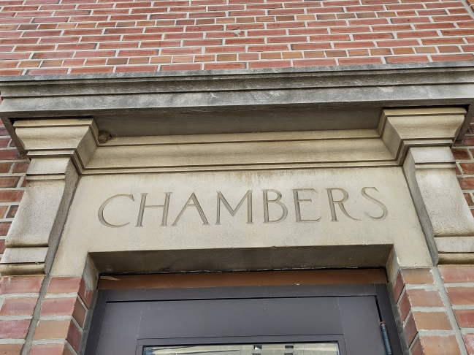
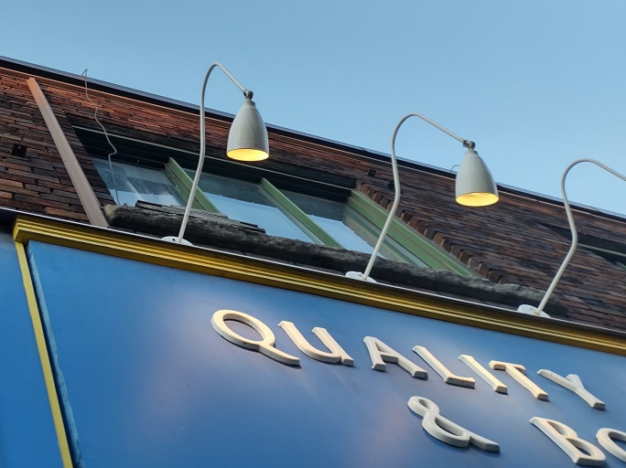
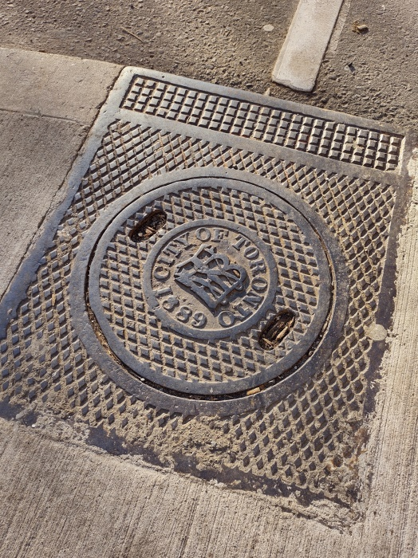
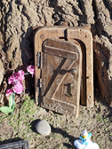
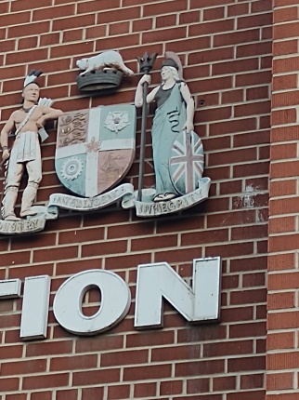
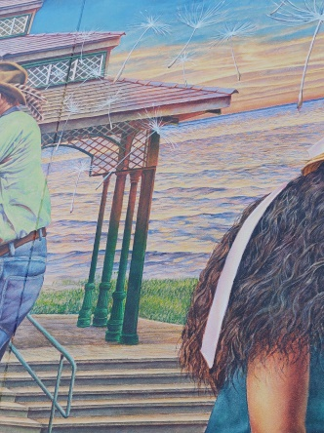
Snowshoe shuffling sleuthing
Tell us the location or cross street when you shuffle past to see these sights!
2. Where am I?
1. Where am I?
5. Where am I?
4. Where am I?
3. Where am I?
6. Where am I?

Slide 6
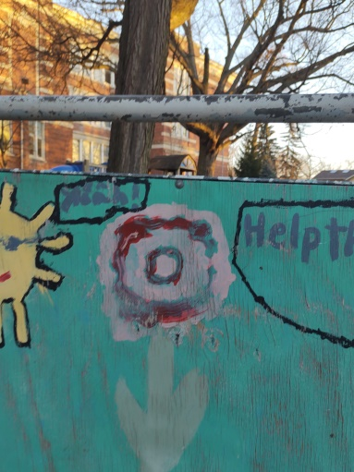
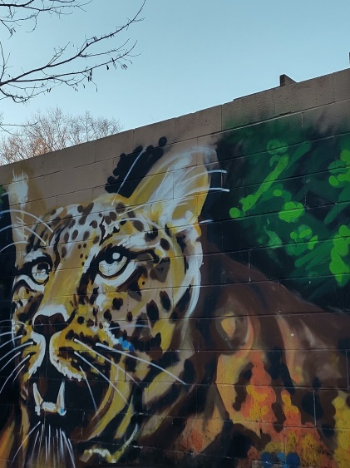
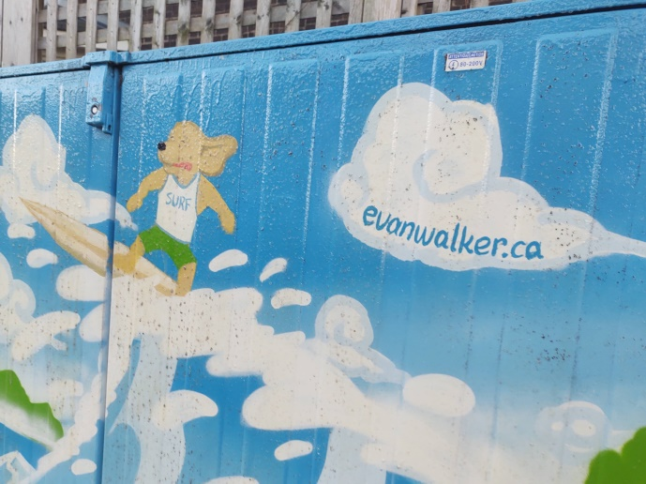
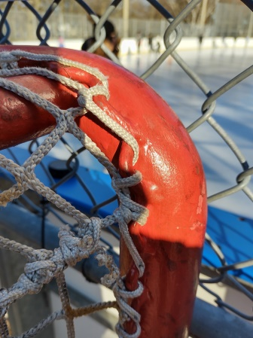
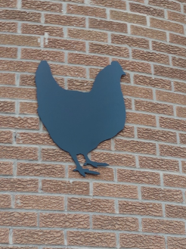
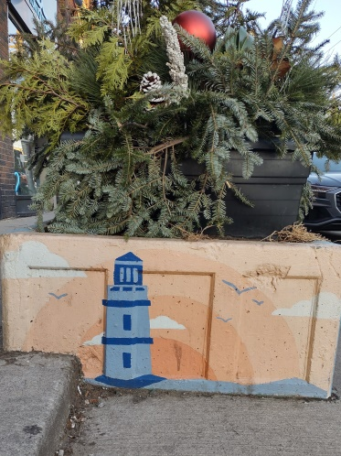
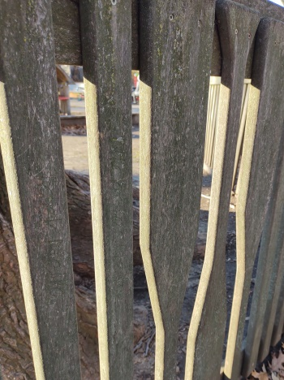
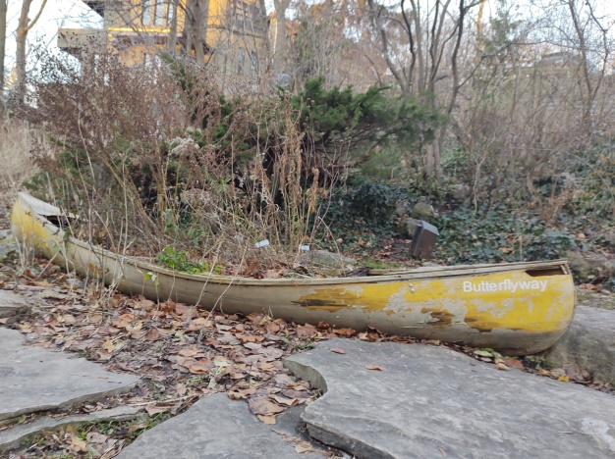
8. Where am I?
9. Where am I?
7. Where am I?
12. Where am I?
11. Where am I?
13. Where am I?
10. Where am I?
14. Where am I?

Slide 7
Willy Walk Answer Sheet
Snowshoe shuffling sleuthing
Magical Mathematical Meander
= __________________________
Stroll and Spot
Picture perfect plodding

